Slide 1
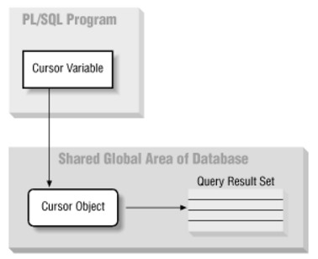
Cursors
http://docstore.mik.ua/orelly/oracle/prog2/ch06_12.htm

Slide 2
Cursor
Special construct in PL/SQL
Holds data returned by SQL query
Held in reserved area of memory
on DBMS server (not client)

Slide 3
Implicit / Explicit Cursors
implicit cursor
created by Oracle on query execute
1 row only;
If 2 rows returned, TOO_MANY_ROWS exception
explicit cursor
we create, more control
reusable, more efficient
multiple rows

Slide 4
Implicit Cursor Example
BEGIN
SELECT col1, col2,
INTO var1, var2
FROM table WHERE condition;
END;
No way to handle multiple rows.

Slide 5
Explicit Cursor Example
DECLARE
CURSOR cur IS
SELECT col1, col2
FROM table WHERE condition;
BEGIN
OPEN cur;
FETCH cur INTO var1, var2;
CLOSE cur;
END;

Slide 6
Declaration
CURSOR cname IS select-query;

Slide 7
Open
Executes the SQL command
populates the cursor with data
opens the cursor for processing
Before you can use a cursor, you need to open it.
OPEN cname;

Slide 8
Fetch
retrieves data from the cursor
copies it to PL/SQL variables for processing
FETCH cname INTO v1
FETCH cname INTO v1, v2

Slide 9
More about Fetch
PL/SQL variables used to hold the data must be declared in the DECLARE section and must:
have data types compatible with the columns retrieved by the SQL command. If the cursors SQL statement returns five columns, there must be five PL/SQL variables to receive the data from the cursor.
This type of processing resembles the one-record-at-a-time processing used in previous database models.
The first time you fetch a row from the cursor, the first row of data from the cursor is copied to the PL/SQL variables.
The second time you fetch a row from the cursor, the second row of data is placed in the PL/SQL variables; and so on.

Slide 10
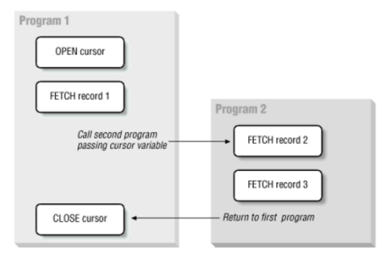
Close
Closes the cursor for processing.
CLOSE cname;
http://docstore.mik.ua/orelly/oracle/prog2/ch06_12.htm

Slide 11
Cursor Attributes
Attribute | Description
%ROWCOUNT | Returns the number of rows fetched so far. If the cursor is not OPEN, it returns an error. If no FETCH has been done but the cursor is OPEN, it returns 0.
%FOUND | Returns TRUE if the last FETCH returned a row and FALSE if not. If the cursor is not OPEN, it returns an error. If no FETCH has been done, it contains NULL.
%NOTFOUND | Returns TRUE if the last FETCH did not return any row and FALSE if it did. If cursor is not OPEN, it returns an error. If no FETCH has been done, it contains NULL.
%ISOPEN | Returns TRUE if the cursor is open (ready for processing) or FALSE if the cursor is closed. Before using a cursor, you must open it.

Slide 13
Learn more
Working with Cursors:
http://www.oracle.com/technetwork/issue-archive/2013/13-mar/o23plsql-1906474.html

Slide 14
Cursors
The End

